Slide 1

GROUP 10

Slide 2
ASTEROID LANDINGS ON EARTH: AN INTERACTIVE VISUALIZATION

Slide 3
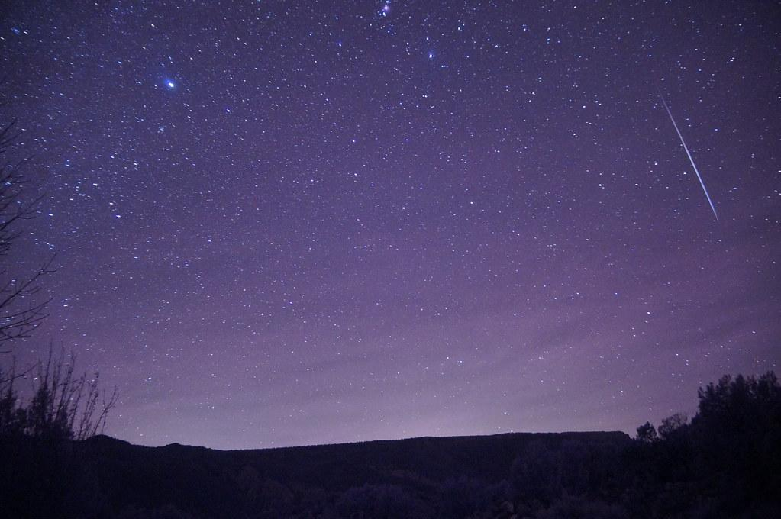
Introduction
What are meteorites?
Meteorites are meteor remnants that made it through the earth's atmosphere without burning up entirely.
Where do meteorites come from?
Most meteorites found on Earth come from shattered asteroids, Mars or the Moon. In theory, small pieces of Mercury or Venus could have also reached Earth.
Why should we study meteorites?
Knowledge of the meteorite’s composition and structure will provide important information on the chemical mixture, and conditions from which the Earth formed 4.6 billion years ago
More reasons to study meteorites?
It has been estimated that the mineral wealth resident in the belt of asteroids between the orbits of Mars and Jupiter would be equivalent to about 100 billion dollars for every person on Earth today.

Slide 4
Overview
Data Analysis and Accompanying Graphs
Interactive Meteorite Map
Meteorite Impact Location Heat Map
Conclusion

Slide 5
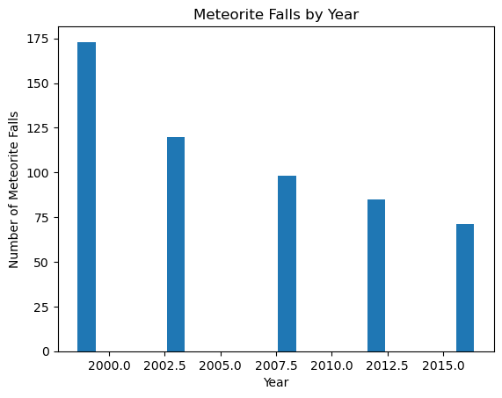
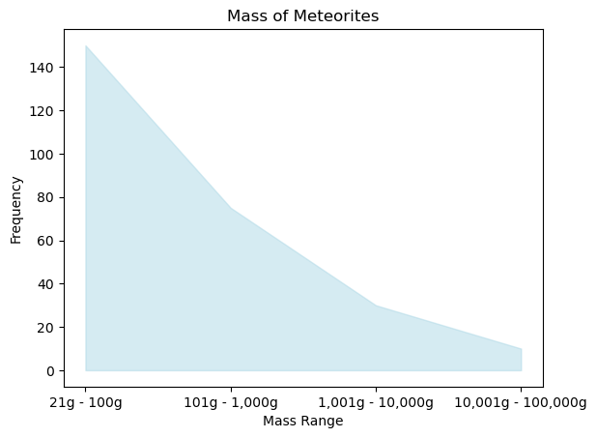
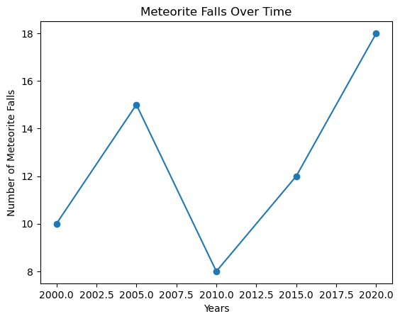
VISUALIZATION- ANALYSIS
From the year 1999-2016 how many meteorites have fallen?
Using those years for analysis, does mass correspond with number of meteorite falls

Slide 6
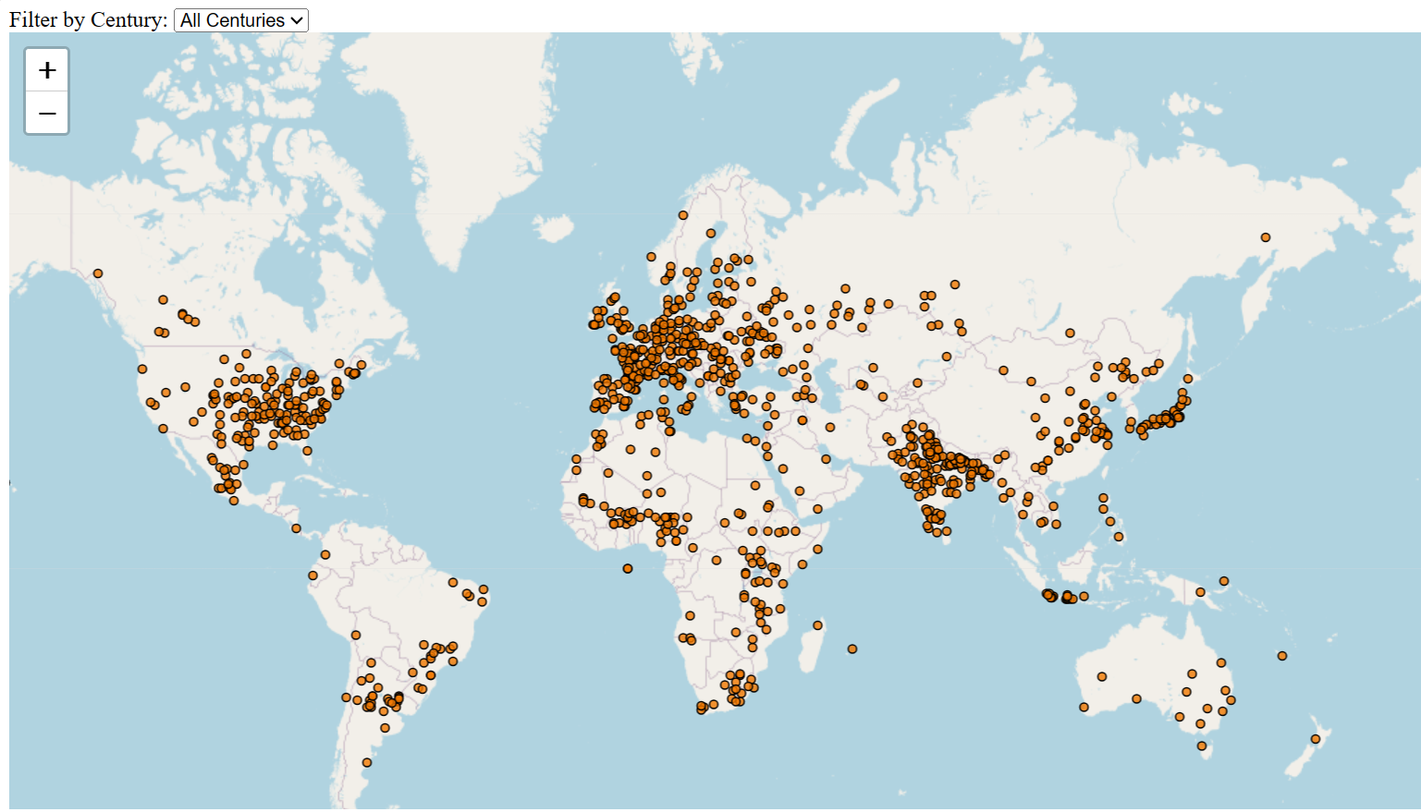
INTERACTIVE METEOR MAP
Constructed using Flask, JavaScript, HTML, CSS, and Python
Showcases reported meteorite impact locations
Allows users to filter by century
Highlights some potential biases in the dataset

Slide 7
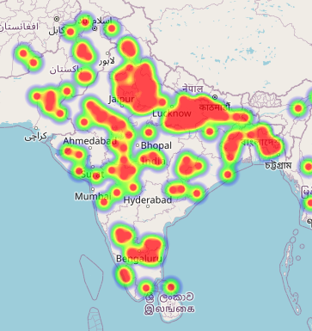
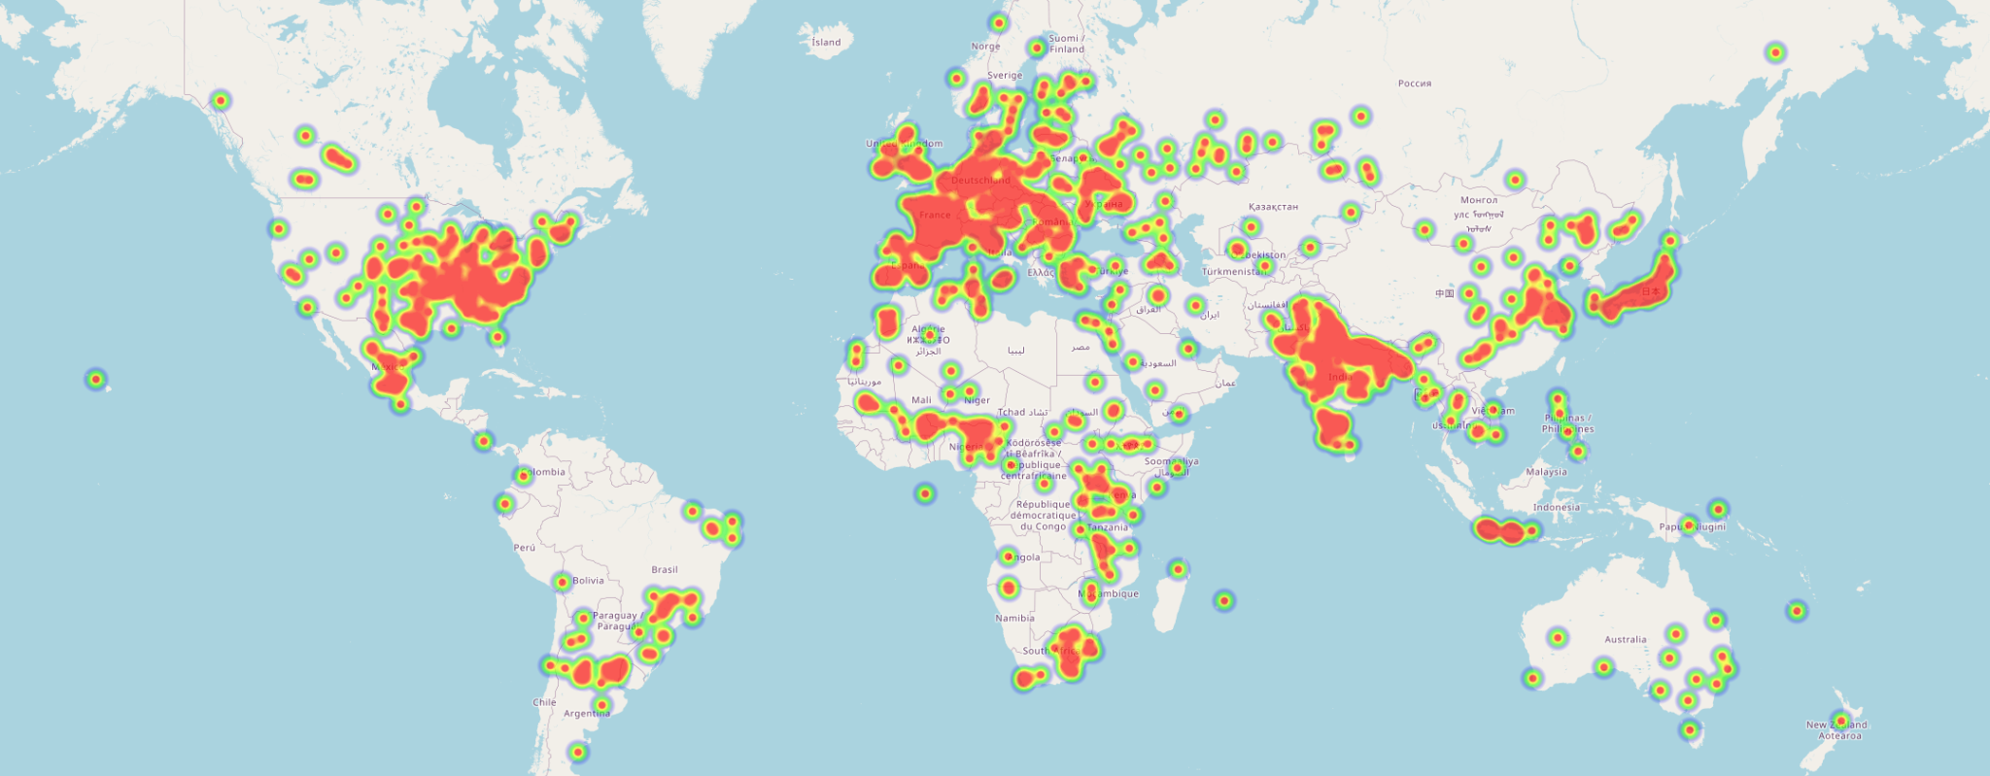
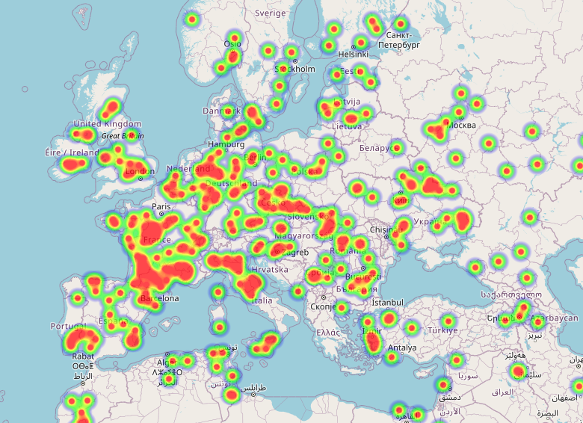
METEOR HEAT MAP
Using the Folium library plugin HeatMapWithTime we are better able to visualize the landing behavior of meteorites throughout the years.
We are able to make an educated guess using this heatmap on how terrain might affect meteorite landings.
This information allows us to make more refined and accurate efforts when searching for meteorites!

Slide 8
Ethical Considerations
Meteorites are very important for various of reasons.
They're very informative on knowledge of our solar system and the formation of the earth 4.5 billion years ago
Meteorites aren't humans and due to this can't really give consent
Our project aligns well with ethical processes that could arise from such research on meteors
our research had little to no complex conditions that could pose a potential risk to our solar system.

Slide 9
Conclusions
There wasn’t any correlation between year and number for meteorites fallen.
There is a correlation between decreased mass and increased frequencies.
In recent years scientists have been able to collect more meteorite impact data then in the past

Slide 10
REFERENCES:
https://www.livescience.com/15445-fallen-stars-gallery-famous-meteorites.html
https://ssd.jpl.nasa.gov/sb/why_asteroids.html
https://science.nasa.gov/solar-system/meteors-meteorites/facts/#hds-sidebar-nav-8
https://www.astronomy.com/science/how-do-scientists-study-meteorites/

